Slide 1
Phase Resetting and its application to analysis of neural circuits
Selva K. Maran
Advisor: Prof. Carmen C. Canavier Ph.D.

Slide 2
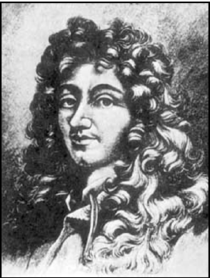
History of Coupled Oscillation
Christiaan Huygens
Notes:
The work that I am doing comes under the field called “coupled oscillations”.
This was originally discovered by the Dutch scientist Christiaan Huygens, 350 years ago. Huygens had two pendulum clocks that were suspended on a beam in his room. He observed an interesting phenomena in these two pendulum clocks.
The pendulum in these two clocks were oscillating always in synchrony. To make sure that this is something that is not happening by accident he disturbed the pendulums so that the synchrony will go away. He found that, after sometime the pendulums started oscillating again in synchrony. He repeated this many times and found that the pendulums always returned back to synchronous oscillation. Excited by this finding he did many experiments and concluded that there should be some weak physical force between these two oscillations that make them to oscillate in synchrony.
He reported his findings to Royal society at London but his views were not given much importance. Disappointed, Huygens did not explore the coupled oscillation further. The phenomena was not reported by anyone for next 250 years.
In the early part of 20th century, similar phenomena was reported but in a totally different setting; It was seen in fireflies.

Slide 3
Synchrony in Fireflies

Slide 4
Nature in Sync
Synchronization is seen in nature at every scale from Atoms to Cosmos
Lasers, Superconductors
Crickets chirp
Pacemaker cells in Heart
Natural satellites go around planet in synchronized orbits.
Synchonization in neurons
Cognitive processing - Attention
Central Pattern generators for rhythmic behaviors
Disease states – Epilepsy, Parkinson’s disease
Notes:
This phenomena of synchrony due interaction of many oscillators …. (Avoid monotonous and it is sort of summing up the main point)
Crickets chirp in unison
We are interested in nervous system and synch. has been observed in neurons during ..

Slide 5
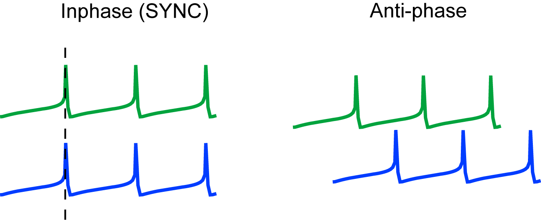
Phase Locking in Coupled Oscillators
Interaction.
Continuous.
Discrete – Pulse Coupled Oscillators.
Notes:
Now synchrony is not the only coordinated behavior that emerges from the interaction of individual oscillators. There could be many other stable phase locked states that can arise.
For example what you are seeing in left side is two pendulums oscillating in synchrony and what you are seeing in the right side is the two pendulums oscillating out of phase with each other, i.e if one pendulum is in the left extreme then the other will be in the right extreme.
My work involves understanding the pulse coupled oscillators and we use the phase resetting methods to study pulse coupled oscillators.

Slide 6
Specific Aims
To predict 1:1 and 2:2 modes in reciprocally coupled heterogeneous inhibitory neurons.
To understand the phase resetting in bursting neurons for excitatory inputs.
To predict phase locking in a network with reciprocally coupled pacemaker (oscillatory) neuron and post inhibitory rebound (PIR) neuron.
Goal: To apply phase resetting methods to understand the phase locking seen in different neural circuits
Notes:
Be aware of phrases

Slide 7
Specific Aim 1
Can the pulse coupling methods predict 1:1 and 2:2 modes in reciprocally coupled heterogeneous inhibitory neurons?
Notes:
Be aware of phrases …

Slide 8
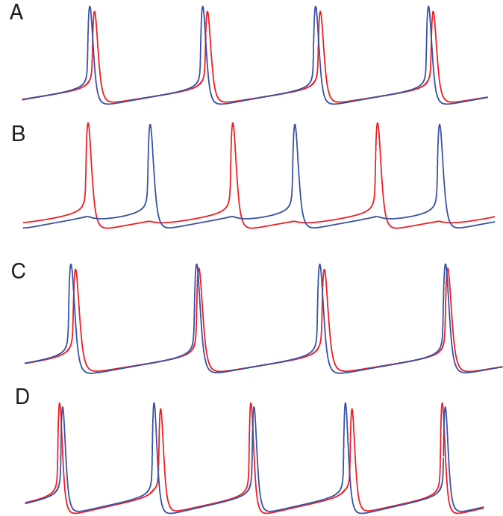
1:1 and 2:2 modes
P₁
P₁
1:1 near synchrony
1:1 Near Antiphase
P₁
P₂
P₁
2:2 regular
2:2 leapfrog
Notes:
In heterogeneous neurons instead of perfect synchrony or perfect Antiphase; you see near synchrony or near Antiphase;
The figure here shows …. That we studied
1:1 include
In heterogeneous cond. you see near synchrony instead of ..
Figure c and d corresponds to ..
Instead of firing interval being remaining same for every cycle; cycles with even number and cycles with odd number ….

Slide 9

Leapfrog game

Slide 10
Significance
To test whether our Phase Resetting methods can be applied to heterogeneous conditions
To explain the effect of Heterogeneity on behavior of coupled neurons
To test whether our methods predict phase locking without the assumption that firing order should be preserved

Slide 11
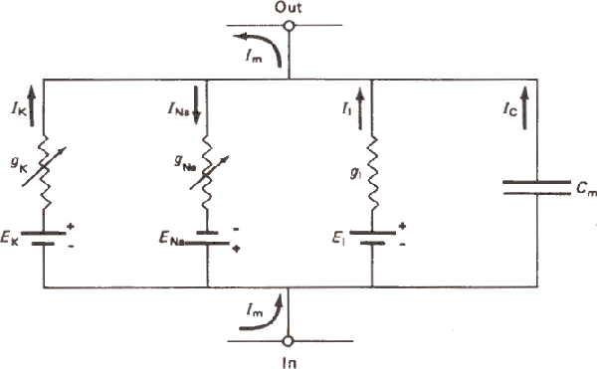
Wang and Buzsaki Model – Hippocampal Interneuron
C_{m} dV/dt = - I_{Na} - I_{K} -I_{L} - I_{syn} +I_{stim}
I_{Na} = g_{Na} m∞³ h (V- E_{Na})
I_{k} = g_{k} n⁴ (V- E_{K})
I_{syn} = g_{syn} s (V-V_{syn})
I_{L} = g_{L} (V- E_{L})
I_{stim,1} = I_{app} + ε
I_{stim,2} = I_{app} – ε
Heterogeneity is in firing rate and is induced by changing – ε (epsilon)
Notes:
Similar to Hodgkin Huxley model
Parameters to be varied
Frequency
Synaptic strength
Applied current
Synaptic time constant
Applied current to make the neuron fire continuously;
Using neuron models we can simulate the actual electrical events that is occuring in real neuron
Heterogeneity is introduced in frequency of firing of neurons by changing the epsilon value and the heterogeneity is studied for different gsyn, tausyn, iapp values.
As you increase the epsilon …

Slide 12
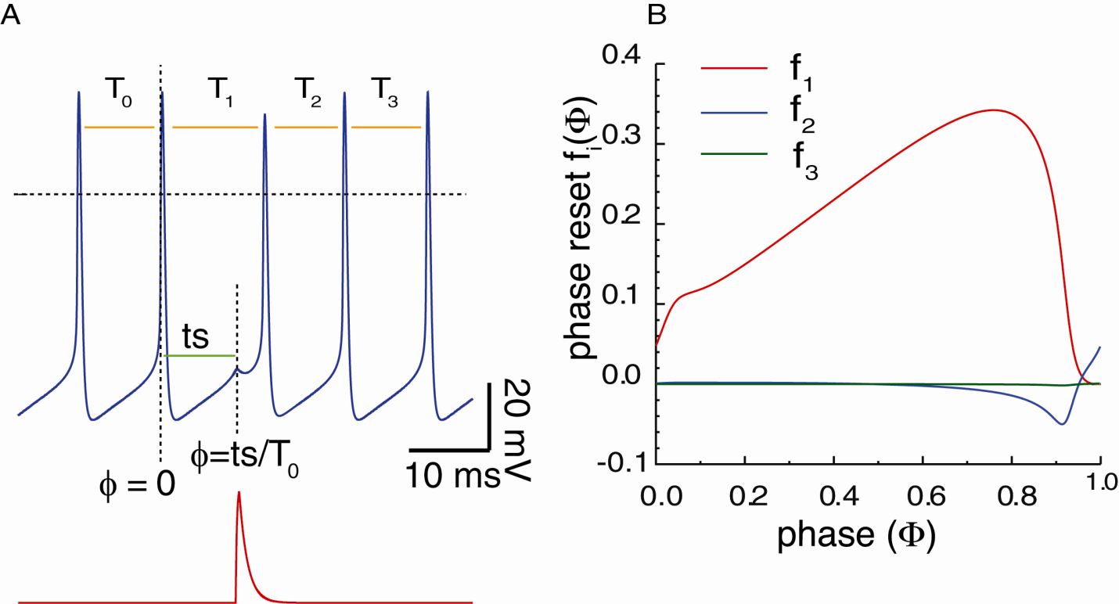

Construction of Open Loop PRC
Construction of PRC
First and second order resetting
Stimulus and Response interval
Periodicity criterion
Graphical Method
Equilibrium points
Stability Criterion
Stable Equilibrium points
Repeat the steps for different
parameter values
Compare observed
and predicted modes
f_{i}(φ) = (T_{i} - T₀)/T₀
i=1,2,3
φ- Phase
f₁ - First Order Resetting,
f₂ - Second Order Resetting,
f₃ - Third Order Resetting.
Positive PRC values – delay
Negative PRC values – advance
f₃ – zero, Small f₂ for late phases
Notes:
People don’t get it and that’s why I am showing for two cycles
Second order is not due to second input;

Slide 13
Basic Assumptions
Neuron is an oscillator
Phase resetting due to previous input is complete before the neuron receives the next input.
Input used to generate the open loop PRC is similar to the input received in the network
Notes:
Burst input duration change

Slide 14
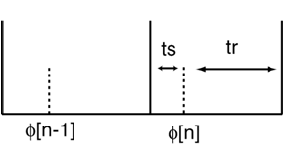
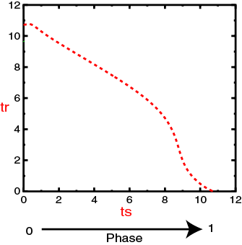
Stimulus Interval (ts) and Response Interval (tr) Construction
Construction of PRC
First and second order resetting
Stimulus and Response interval
Existence criterion
Graphical Method
Equilibrium points
Stability Criterion
Stable Equilibrium points
Repeat the steps for different
parameter values
Compare observed
and predicted modes
Fig:
Small dotted line – input time
Long vertical line – reference point in the spike
ts = T₀ Φ[n] + T₀ f₂(Φ[n-1])
tr = T₀ (1- Φ[n]) + T₀ f₁ (Φ[n])
Notes:
This is spike
This is time at which input is given

Slide 15
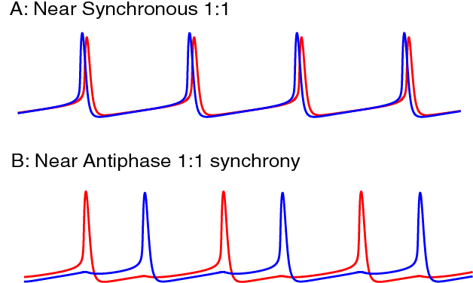
1:1 Phase locking In Two Neuron Heterogeneous Network
Construction of PRC
First and second order resetting
Stimulus and Response interval
Existence criterion
Graphical Method
Equilibrium points
Stability Criterion
Stable Equilibrium points
Repeat the steps for different
parameter values
Compare observed
and predicted modes

Slide 16
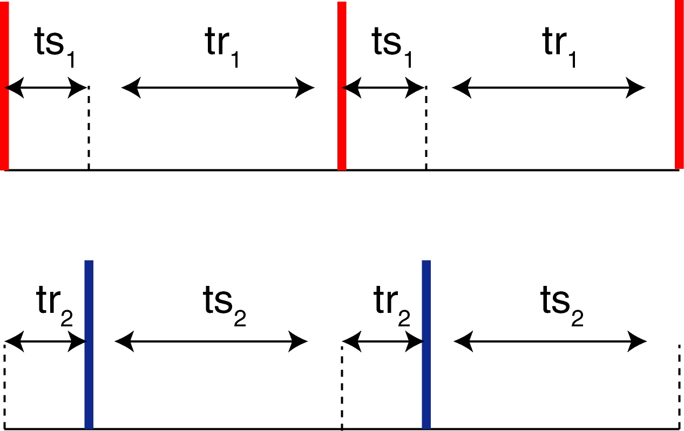
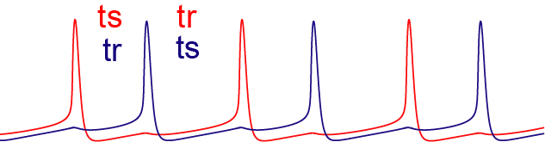
Existence Criterion for 1:1
Construction of PRC
First and second order resetting
Stimulus and Response interval
Existence criterion
Graphical Method
Equilibrium points
Stability Criterion
Stable Equilibrium points
Repeat the steps for different
parameter values
Compare observed
and predicted modes
ts₁ = tr₂; tr₁=ts₂

Slide 17
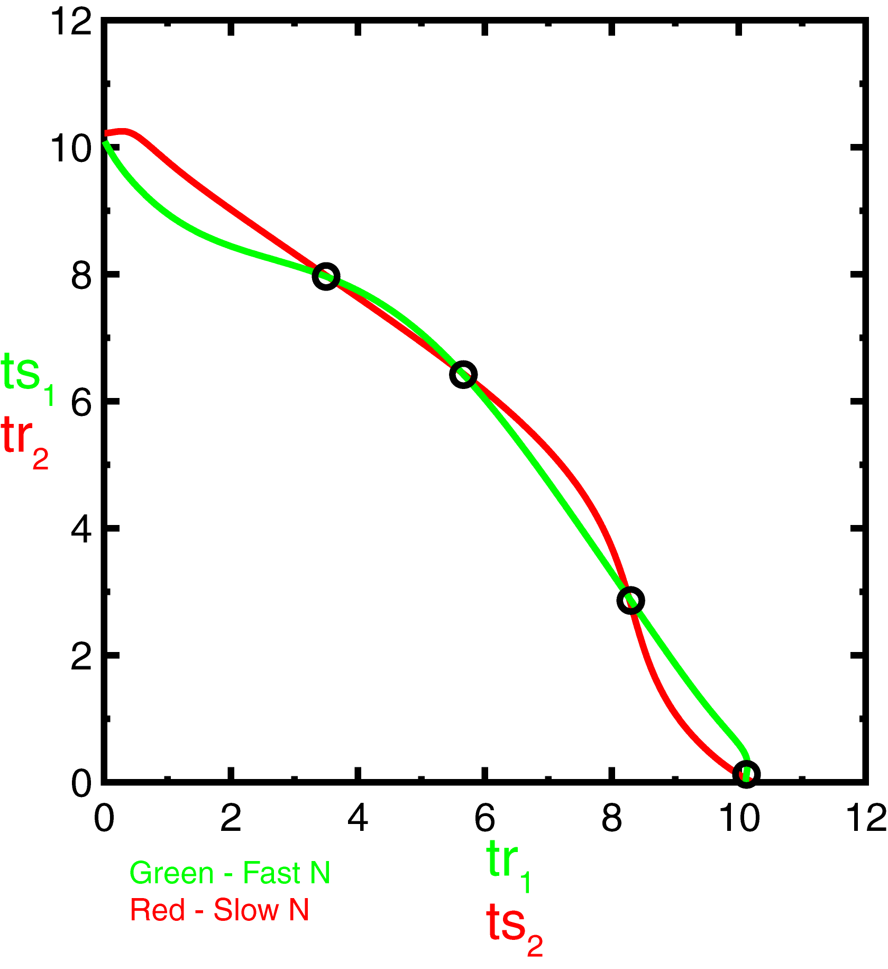
Graphical Method
Construction of PRC
First and second order resetting
Stimulus and Response interval
Existence criterion
Graphical Method
Equilibrium points
Stability Criterion
Stable Equilibrium points
Repeat the steps for different
parameter values
Compare observed
and predicted modes
g_{syn} – 0.25 (μS/cm²)
I_{app} - 2 (μA/cm²)
τ_{syn}– 1 (ms)
ε– 0.015 (μA/cm²)
Plot (ts₂,tr₂) & (tr₁,ts₁)
– Equilibrium points - ts₁ = tr₂; tr₁=ts₂.
Notes:
Black circle (for stable and instable its blue circle)

Slide 18



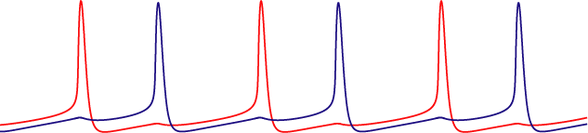
Construction of PRC
First and second order resetting
Stimulus and Response interval
Existence criterion
Graphical Method
Equilibrium points
Stability Criterion
Stable Equilibrium points
Repeat the steps for different
parameter values
Compare observed
and predicted modes
Stability Criterion
Equilibrium (or fixed) points – Stable or Unstable
Notes:
The Equilibrium points could be stable or unstable.
The figure here is a simple illustration of what I meant by stable and unstable fixed points. G is gravity.

Slide 19
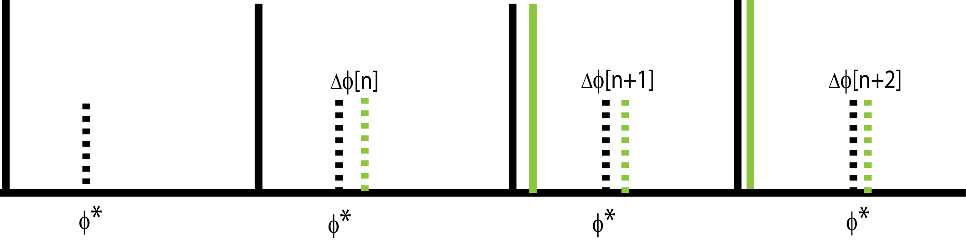
Expression for Stability Criterion
Construction of PRC
First and second order resetting
Stimulus and Response interval
Existence criterion
Graphical Method
Equilibrium points
Stability Criterion
Stable Equilibrium points
Repeat the steps for different
parameter values
Compare observed
and predicted modes
Discrete map method
ΔΦ[n+1] = Α ΔΦ [n] .
if |λ| < 1 stable and |λ| > 1 unstable, where λ are the eigenvalues of A
Linearizing the PRC at steady state
f₁₁[Φ*+ ΔΦ] = f₁₁[Φ*]+ ΔΦ m₁₁[Φ*].
m_{ij} – Slope of i^{th} order resetting of j^{th} neuron (f_{ij}[Φ]).
λ² –λ ((1-m₁₁)(1- m₁₂) – m₂₁ – m₂₂) + m₂₁m₂₂ = 0.
Slope of the PRC at the Equilibrium phases determines stability.
Notes:
The way we derive the stability criteria is by using discrete map method. First we assume that the neuron is perturbed slightly from the equilibrium phase. So that the neuron instead of receiving the input at Φ* it receives at a small distance ΔΦ away from Φ*. Next we write ΔΦ [n+1] as a function of ΔΦ [n].
This is shown here, where we have ΔΦ [n+1] equal to A times ΔΦ [n]. Where A is the two dimensional matrix and Eigenvalues of matrix A determines the stability of the discrete map.
In the process of computing the matrix A we linearize the prc about the fixed point using Taylor series expansion as shown here.
The Eigenvalues are obtained from the characteristic polynomial, corresponding to the matrix A shown here.
PRC has all information to predict the phase locked state.
Why do all these – by constructing the PRC how the neuron will behave when it is interacting in the network even before we connect the two neurons and make them to interact with each other

Slide 20
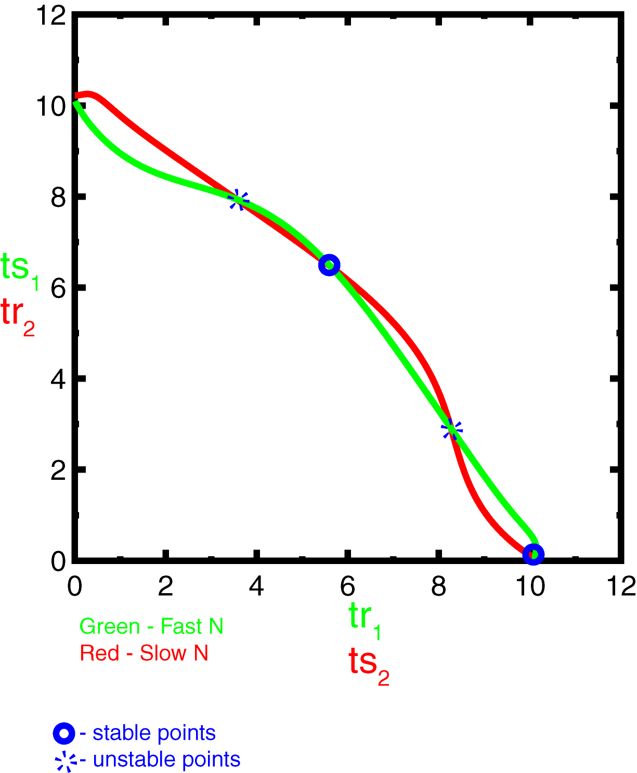
Stable and unstable points
Construction of PRC
First and second order resetting
Stimulus and Response interval
Existence criterion
Graphical Method
Equilibrium points
Stability Criterion
Stable Equilibrium points
Observed modes
Compare observed
and predicted modes
Repeat the steps for different
parameter values
g_{syn} – 0.25 (μS/cm²)
I_{app} - 2 (μA/cm²)
τ_{syn}– 1 (ms)
ε– 0.015 (μA/cm²)
Notes:
An antiphase and inphase predicted

Slide 21
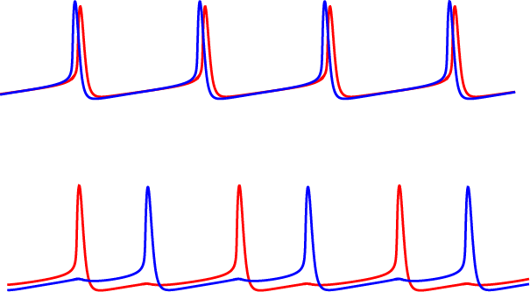

Observed Modes
Construction of PRC
First and second order resetting
Stimulus and Response interval
Existence criterion
Graphical Method
Equilibrium points
Stability Criterion
Stable Equilibrium points
Observed modes
Compare observed
and predicted modes
Repeat the steps for different
parameter values
Near synchronous:
Near Antiphase locking:
g_{syn} – 0.25 (μS/cm²)
I_{app} - 2 (μA/cm²)
τ_{syn}– 1 (ms)
ε– 0.015 (μA/cm²)
Notes:
Different initial conditions

Slide 22

Methods - Summary
I_{app} + ε
I_{app} - ε
Model Neuron
g_{syn} – 0.25 (μS/cm²)
I_{app} - 2 (μA/cm²)
τ_{syn}– 1 (ms)
ε– 0.015 (μA/cm²)
Construction of PRC
I_{app} - ε
I_{app} + ε
(ts₁and tr₁)
(ts₂ and tr₂)
Fixed points
Plot (ts₂,tr₂) & (tr₁,ts₁)
Stable points
Stability Analysis
Model Neurons
g_{syn} – 0.25 (μS/cm²)
I_{app} - 2 (μA/cm²)
τ_{syn}– 1 (ms)
ε– 0.015 (μA/cm²)
I_{app} + ε
Predicted modes
Observed modes
I_{app} - ε

Slide 23
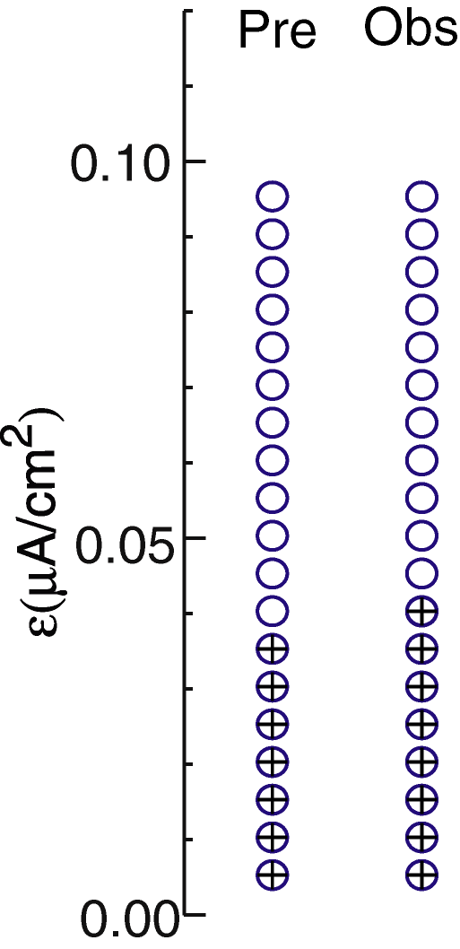
Comparison between Predicted and Observed Modes
Construction of PRC
First and second order resetting
Stimulus and Response interval
Periodicity criterion
Graphical Method
Equilibrium points
Stability Criterion
Stable Equilibrium points
Repeat the steps for different
parameter values
Compare observed
and predicted modes
g_{syn} – 0.25 (μS/cm²)
I_{app} - 2 (μA/cm²)
τ_{syn}– 1 (ms)
ε– 0 to 0.1 (μA/cm²)
Blue ‘o’ - near synchronous 1P (1:1)
Black ‘+’ - near anti phase 1P (1:1)
Notes:
Plot ts tr values (quantitative accuracy)

Slide 24
Effect of heterogeneity in Epsilon
Construction of PRC
First and second order resetting
Stimulus and Response interval
Periodicity criterion
Graphical Method
Equilibrium points
Stability Criterion
Stable Equilibrium points
Repeat the steps for different
parameter values
Compare observed
and predicted modes
g_{syn} – 0.25 (μS/cm²)
I_{app} - 2 (μA/cm²)
τ_{syn}– 1 (ms)
ε– 0.015 (μA/cm²)

Slide 25
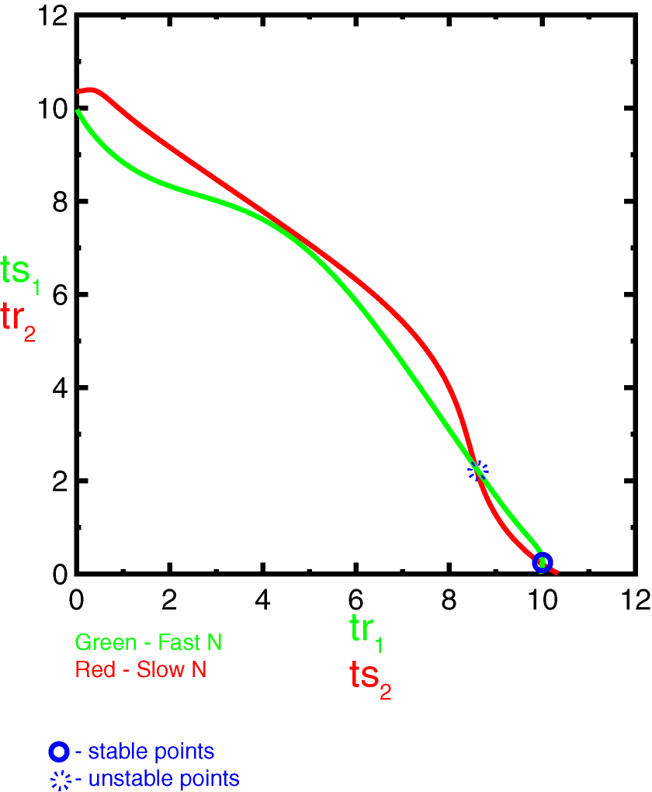
Construction of PRC
First and second order resetting
Stimulus and Response interval
Periodicity criterion
Graphical Method
Equilibrium points
Stability Criterion
Stable Equilibrium points
Repeat the steps for different
parameter values
Compare observed
and predicted modes
Effect of heterogeneity in Epsilon – contd.
g_{syn} – 0.25 (μS/cm²)
I_{app} - 2 (μA/cm²)
τ_{syn}– 1 (ms)
ε– 0.05 (μA/cm²)

Slide 26
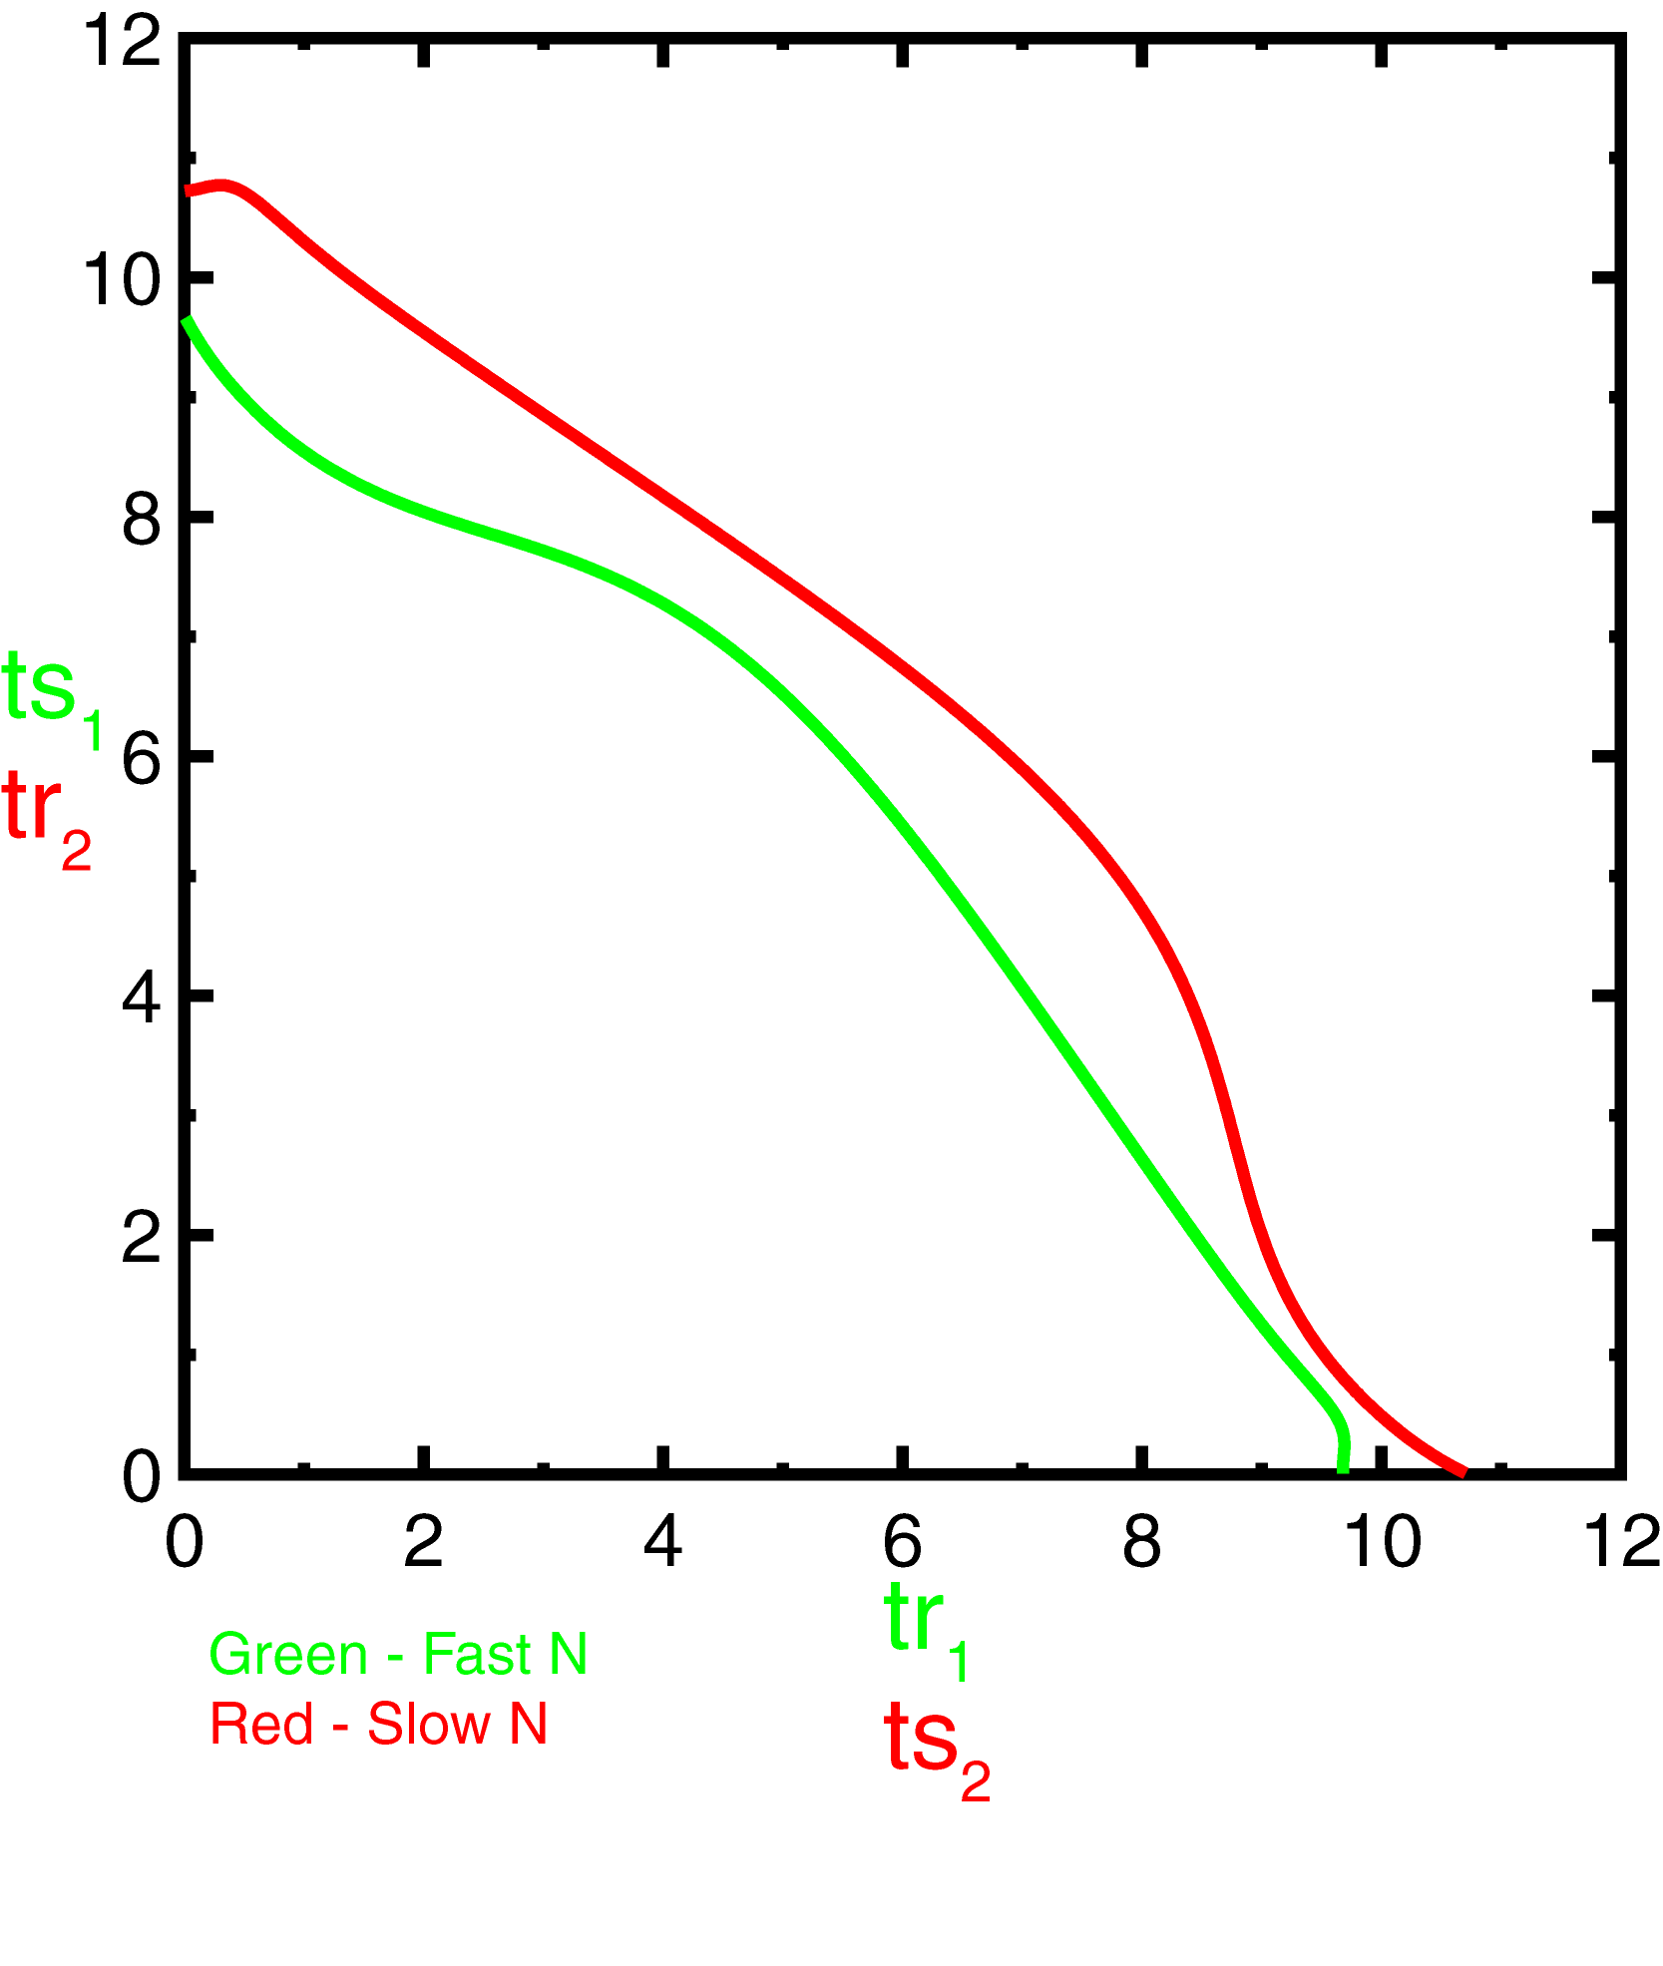
Construction of PRC
First and second order resetting
Stimulus and Response interval
Periodicity criterion
Graphical Method
Equilibrium points
Stability Criterion
Stable Equilibrium points
Repeat the steps for different
parameter values
Compare observed
and predicted modes
Effect of heterogeneity in Epsilon – contd.
g_{syn} – 0.25 (μS/cm²)
I_{app} - 2 (μA/cm²)
τ_{syn}– 1 (ms)
ε– 0.14 (μA/cm²)

Slide 27
2:2 Phase locking In Two Neuron Heterogeneous Network
2:2 regular
2:2 leapfrog

Slide 28
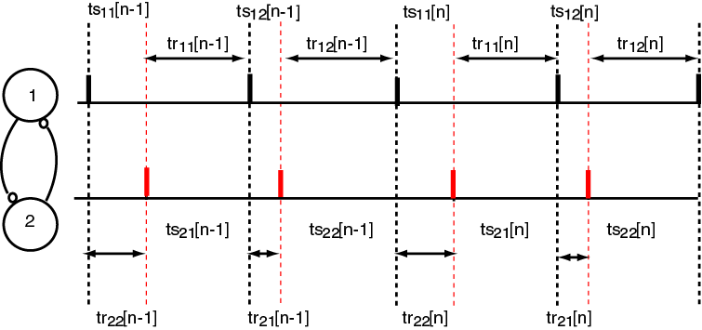
2:2 locking with constant firing order
Construction of PRC
First and second order resetting
Stimulus and Response interval
Periodicity criterion
Graphical Method
Equilibrium points
Stability Criterion
Stable Equilibrium points
Repeat the steps for different
parameter values
Compare observed
and predicted modes
Existence Criterion
ts₁₁=tr₂₂; tr₁₁ = ts₂₁; ts₁₂=tr₂₁; tr₁₂ = ts_{22.}
If ts₁₁ = ts₁₂ then the locking is 1:1 otherwise it is 2:2.

Slide 29
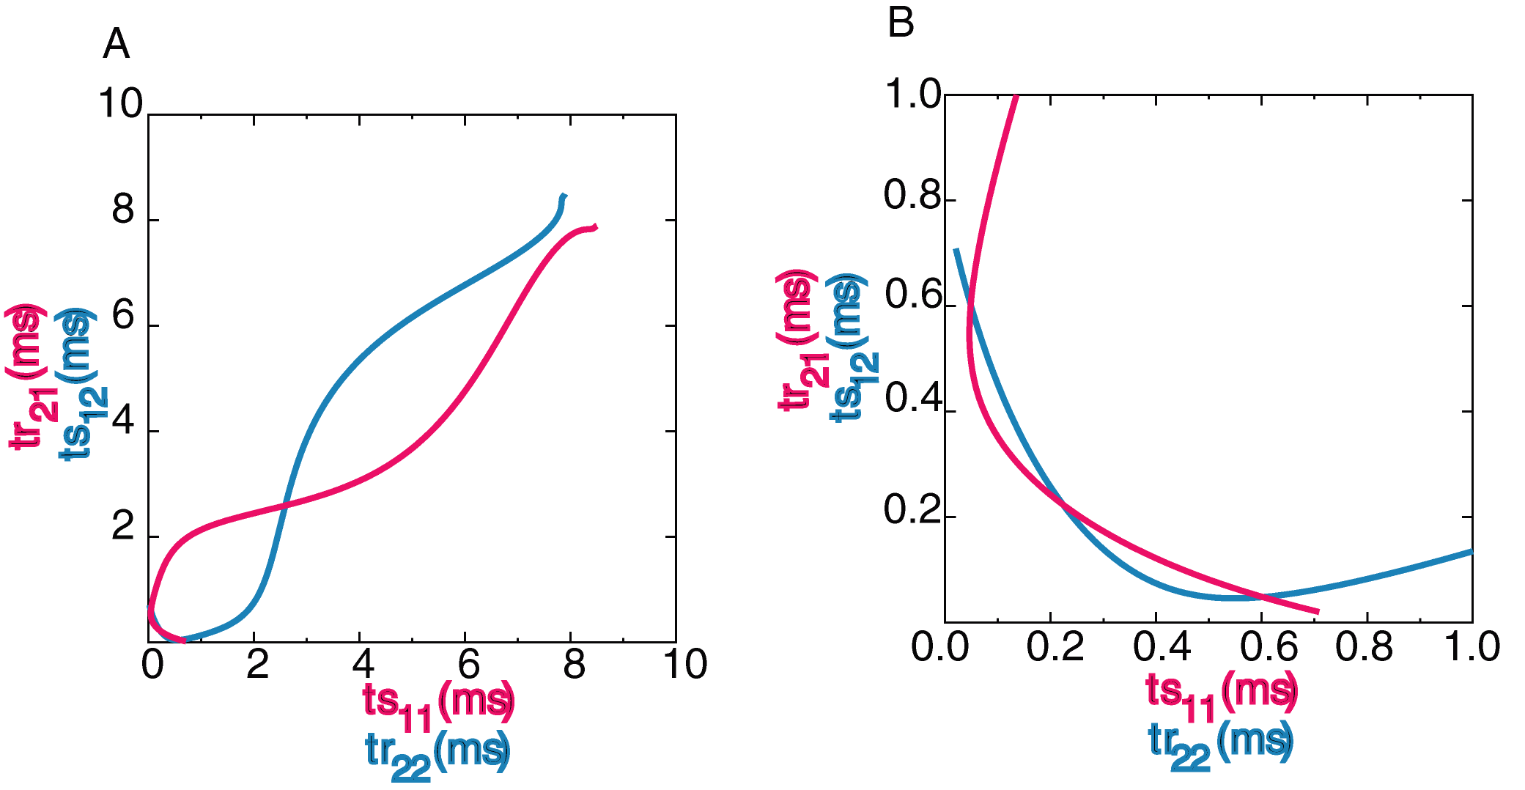
Graphical Method –(2:2 regular)
Construction of PRC
First and second order resetting
Stimulus and Response interval
Periodicity criterion
Graphical Method
Equilibrium points
Stability Criterion
Stable Equilibrium points
Repeat the steps for different
parameter values
Compare observed
and predicted modes
- Stable Points
- Unstable point
g_{syn} – 0.35 (μS/cm²)
I_{app} - 2 (μA/cm²)
τ_{syn}– 1 (ms)
ε– 0.07 (μA/cm²)
ref. Maran & Canavier 2007

Slide 30
Stability criterion for 2:2 locking with constant firing order
Construction of PRC
First and second order resetting
Stimulus and Response interval
Periodicity criterion
Graphical Method
Equilibrium points
Stability Criterion
Stable Equilibrium points
Repeat the steps for different
parameter values
Compare observed
and predicted modes
Δφ₁₁ [n] = (P₂/P₁) (m₁₂₂-1) Δφ₂₂ [n-1]- m₂₁₂ Δφ₁₂ [n-1];
Δφ₂₁ [n] = (P₁/P₂) (m₁₁₁-1) Δφ₁₁ [n]- m₂₂₂ Δφ₂₂ [n];
Δφ₁₂ [n] = (P₂/P₁) (m₁₂₁-1) Δφ₂₁ [n]- m₂₁₁ Δφ₁₁ [n];
Δφ₂₂ [n] = (P₁/P₂) (m₁₁₂-1) Δφ₁₂ [n]- m₂₂₁ Δφ₂₁ [n];
0 = λ² + λ [ -(1 - m₁₁₁) (1 - m₁₁₂)(1 - m₁₂₁)(1 - m₁₂₂) +
m₂₁₁(1 - m₁₁₂)(1 - m₁₂₂) + m₂₂₁(1 - m₁₁₁)(1 - m₁₂₂) +
m₂₁₂(1 - m₁₁₁)(1 - m₁₂₁) + m₂₂₂(1 - m₁₁₂)(1 - m₁₂₁)
- m₂₁₁m₂₁₂ - m₂₂₁m₂₂₂ ] + m₂₁₁m₂₁₂m₂₂₁m₂₂₂
Ιf f_{2j}(φ) = 0 λ = (1 - m₁₁₁) (1 - m₁₁₂)(1 - m₁₂₁)(1 - m₁₂₂)
m_{ijk} is the slope of f_{ij} at input phase φ_{jk}

Slide 31
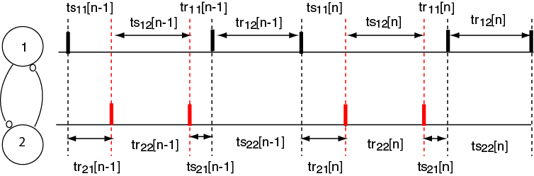
2:2 leapfrog locking
Alternating Firing Order (“Leapfrog”)
Existence Criterion
ts₁₁=tr₂₁ ts₂₁ = tr₂₂ tr₁₁=ts₂₁ tr₁₂ = ts_{22.}

Slide 32
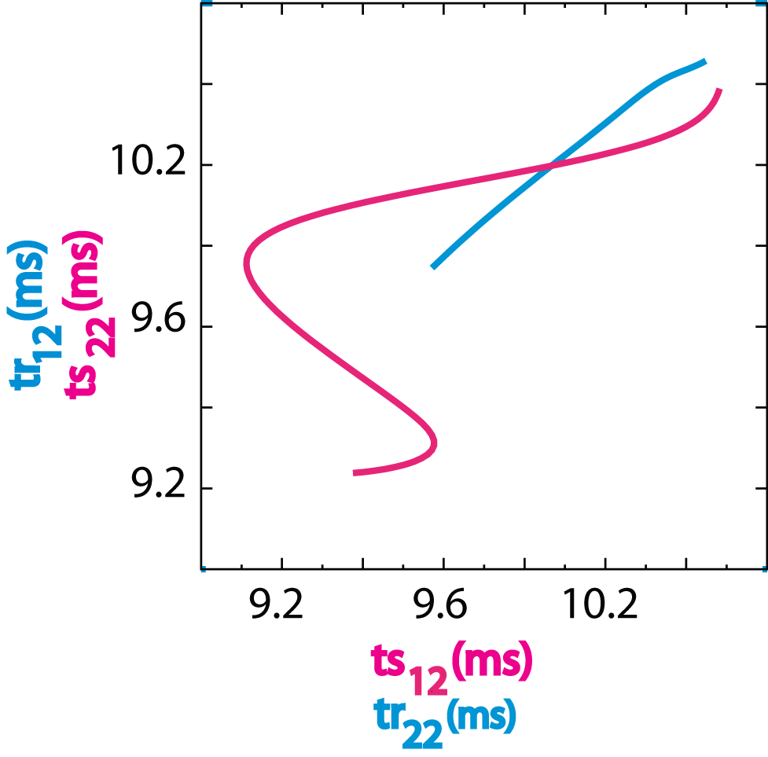
Graphical Method (Leap frog)
- Stable Fixed Point
g_{syn} – 0.35 (μS/cm²)
I_{app} - 2 (μA/cm²)
τ_{syn}– 1 (ms)
ε– 0.03 (μA/cm²)
ref. Maran & Canavier 2007

Slide 33
Stability criterion for 2:2 leapfrog locking
Δφ₁₁ [n] = (P₂/P₁)(m₁₂₂-1) Δφ₂₂ [n-1];
Δφ₂₁ [n] = (P₁/P₂)(m₁₁₂-1) Δφ₁₂ [n];
Δφ₁₂ [n] = (1-m₁₁₁) Δφ₁₁[n] + (P₂/P₁)m₂₂₁ Δφ₂₁[n-1] + (P₂/P₁) m₂₂₂ Δφ₂₂[n-1];
Δφ₂₂ [n] = (1 - m₁₂₁) Δφ₂₁[n] + (P₁/P₂)m₂₁₁ Δφ₁₁ [n]- (P₁/P₂) m₂₁₂ Δφ₁₂ [n];
0 = λ² - λ [m₂₂₁(m₁₁₂ - 1) + m₂₁₁(m₁₂₂ - 1) + (m₂₁₂ + (1-m₁₂₁)(m₁₁₂ -1))(m₂₂₂ + (1 - m₁₁₁)(m₁₂₂ - 1))] + m₂₁₁m₂₂₁(1 - m₁₁₂)(1 - m₁₂₂)
Ιf f_{2j}(φ) = 0 λ = (1 - m₁₁₁) (1 - m₁₁₂)(1 - m₁₂₁)(1 - m₁₂₂)

Slide 34

Effect of synaptic time constant
Period ~ 10ms
Blue ‘o’ - near synchronous 1P (1:1)
Black ‘+’ - near anti phase 1P (1:1)
Red ‘o’ - 2:2 regular
g_{syn} – 0.2 (μS/cm²)
I_{app} - 2 (μA/cm²)
(ref. Maran & Canvier 2007)

Slide 35
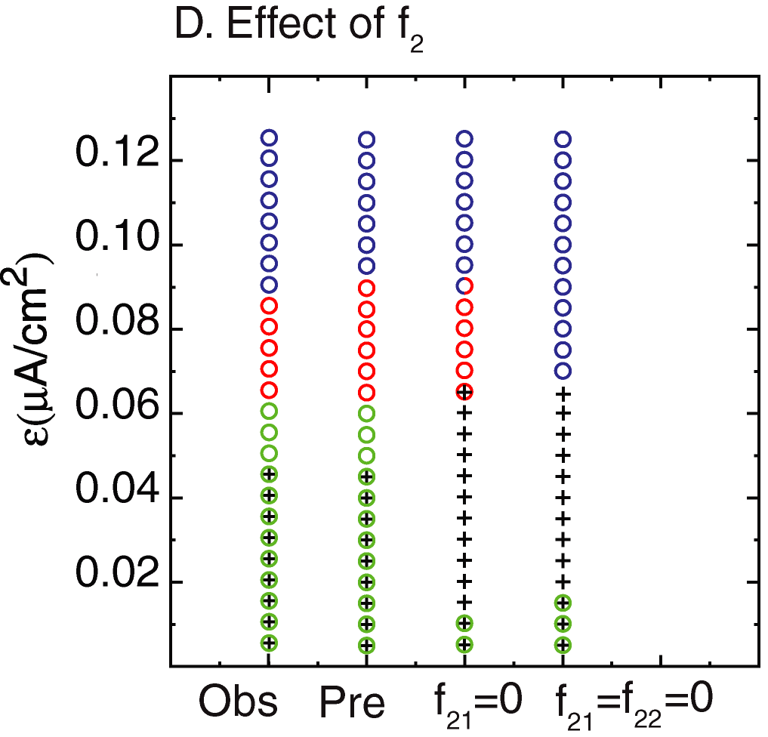
Effect of second order resetting (f₂) on prediction
g_{syn} – 0.35 (μS/cm²)
I_{app} - 2 (μA/cm²)
τ_{syn}– 1 (ms)
Blue ‘o’ - near synchronous 1P (1:1)
Black ‘+’ - near anti phase 1P (1:1)
Red ‘o’ - 2:2 regular ; Green ‘o’- 2:2 Leapfrog
(ref. Maran & Canvier 2007)

Slide 36
Summary (Aim 1)
PRCs methods are successfully able to predict 1:1 and 2:2 modes provided the synaptic time constant is short
Second order resetting is important for 2:2 predictions
Stability proof also satisfied the cases where firing order is not preserved (2:2 leapfrog).

Slide 37
Specific Aim 2

Slide 38
Specific Aim 2
To study phase resetting in a bursting neuron for excitatory inputs of different strength and duration
To explain the biophysical mechanism for the phase resetting using a model neuron

Slide 39
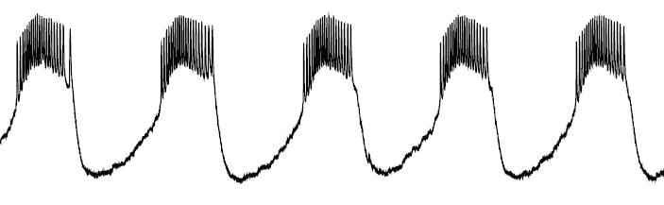
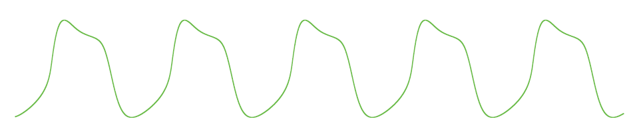
Bursting
Voltage trace from a regularly bursting neuron
One cycle
P₀
Notes:
One cycle
Just saying something that they already knew and sort of relevant here (to get their attention) (before – not sure what is relevant in this slide and now)
What is shown ….V trace ……..
Is a Firing pattern,
Burst -> Time interval during which …….interburst interval -> remains silence
Pattern repeats in time
Truncated …
One Spiking interval followed by the silence interval constitutes …… Cycle
When there is no disturbance the cycle length almost remains the same – P₀

Slide 40
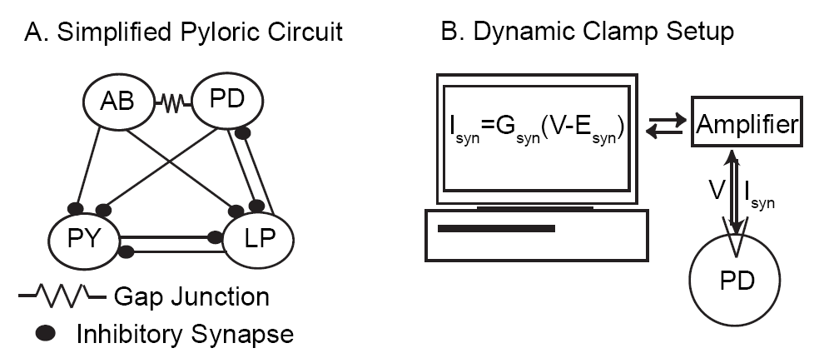


Experimental Setup
Experiments were done by Dr. Astrid Prinz Lab at Emory University, Atlanta
Notes:
How to put it?
Basically we were interested to study phase resetting in an intrinsically bursting neuron and the neuron that we chose is the
How to say the main points?
State the neurons?
Couple of important points here -
1) AB is main pacemaker neuron
2) Single unit
3) Why into PD
4) LP is blocked
5) Excitatory inputs
How the Artificial synaptic input is given?
No need to give more details …
using the dynamic clamp
Whenever the input has to be applied the Gsyn is changed from zero to desired set value and the V measure ………..

Slide 41
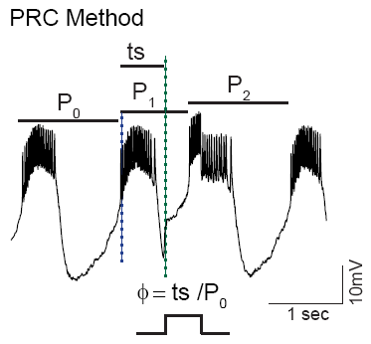
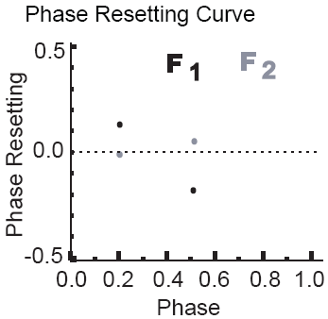
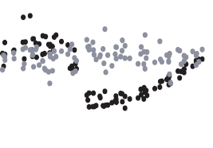
Phase Resetting Curve
Change in first cycle length -> (P₁ - P₀)
f₁(φ) = (P₁ - P₀)/P₀
f₁ - First Order Resetting
Change in second cycle length -> (P₂ - P₀)
f₂(φ) = (P₂ - P₀)/P₀
f₂ - Second Order Resetting
Notes:
Phase
We refer the time at which input is given within a cycle in terms of phase
Reference point - Blue line
Stimulus interval -Green line
Phase
0,0.5,1 (stressing more – something which people don’t get at first time)
So phase is just, normalizing the stimulus time at which input is given within a cycle
Phase reset
Second cycle after the input cycle
Second order resetting is not resetting due to input given in second cycle; it is actually the reset you see in second cycle due to an input in the previous cycle (stressing more – something which people don’t get at first time)
Phase resetting is also normalizing the change in cycle length

Slide 42
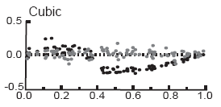
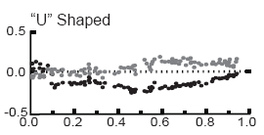
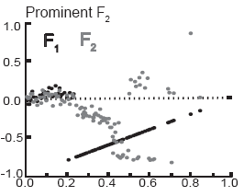
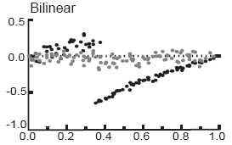
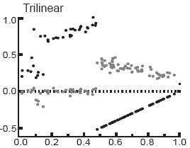
Five different PRC shapes
Short
<1/6th of P₀
Intermediate
1/6th – 1/3rd of P₀
Long
>1/3rd of P₀
Weak
Negligible resetting
Strong
P₀-> Intrinsic period or period of unperturbed cycle
Notes:
P₀-> Intrinsic period or period of unperturbed cycle
Short
<1/6th of P₀
1/6th – 1/3rd of P₀
>1/3rd of P₀
Long
Intermediate
Weak
Strong

Slide 43
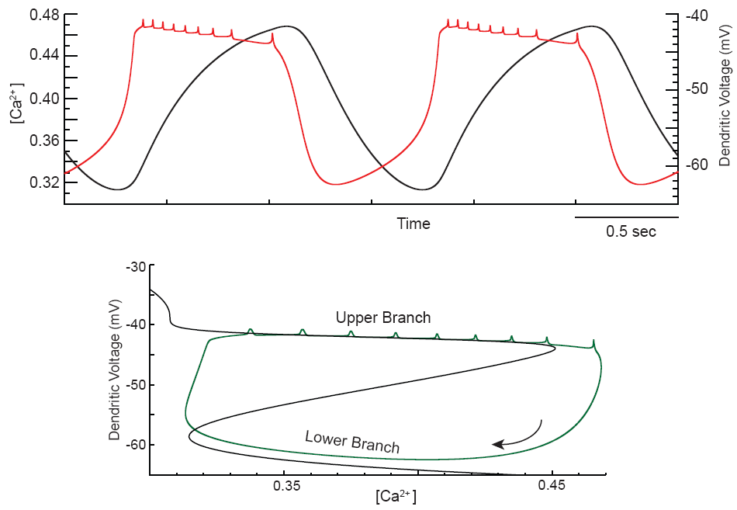
Phase plane Analysis
Dendritic voltage - fast variable
Calcium - slow variable
The black curve represents points where net current flow across membrane is zero
Notes:
Black curve represents points where net membrane current is zero
Dendritic voltage - fast variable
Calcium - slow variable
Calcium channels gets activated fast on depolarization
Calcium channels gets deactivated fast on hyperpolarization
Neuron goes to upper branch when Calcium channels gets activated
Neuron goes to lower branch when Calcium channels gets deactivated
Slow dynamics for Calcium
Ca channels active
Ca channels deactive
Goes round and round this closed curve
Gets deviated when the input is given
Outward current is dominant below the black curve
Inward current is dominant above the black curve (conductance change – positive feedback)

Slide 44
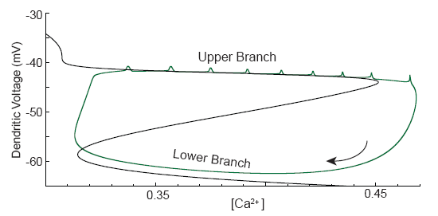
Branch switching hypothesis
Calcium channels activate (deactivate) fast on depolarization (hyperpolarization)
Rate of change of calcium is slow
Relaxation oscillator
Our Original Hypothesis of aim 2 was to verify branch switching hypothesis for short strong excitatory inputs

Slide 45
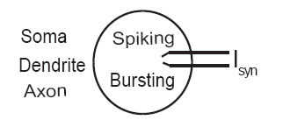
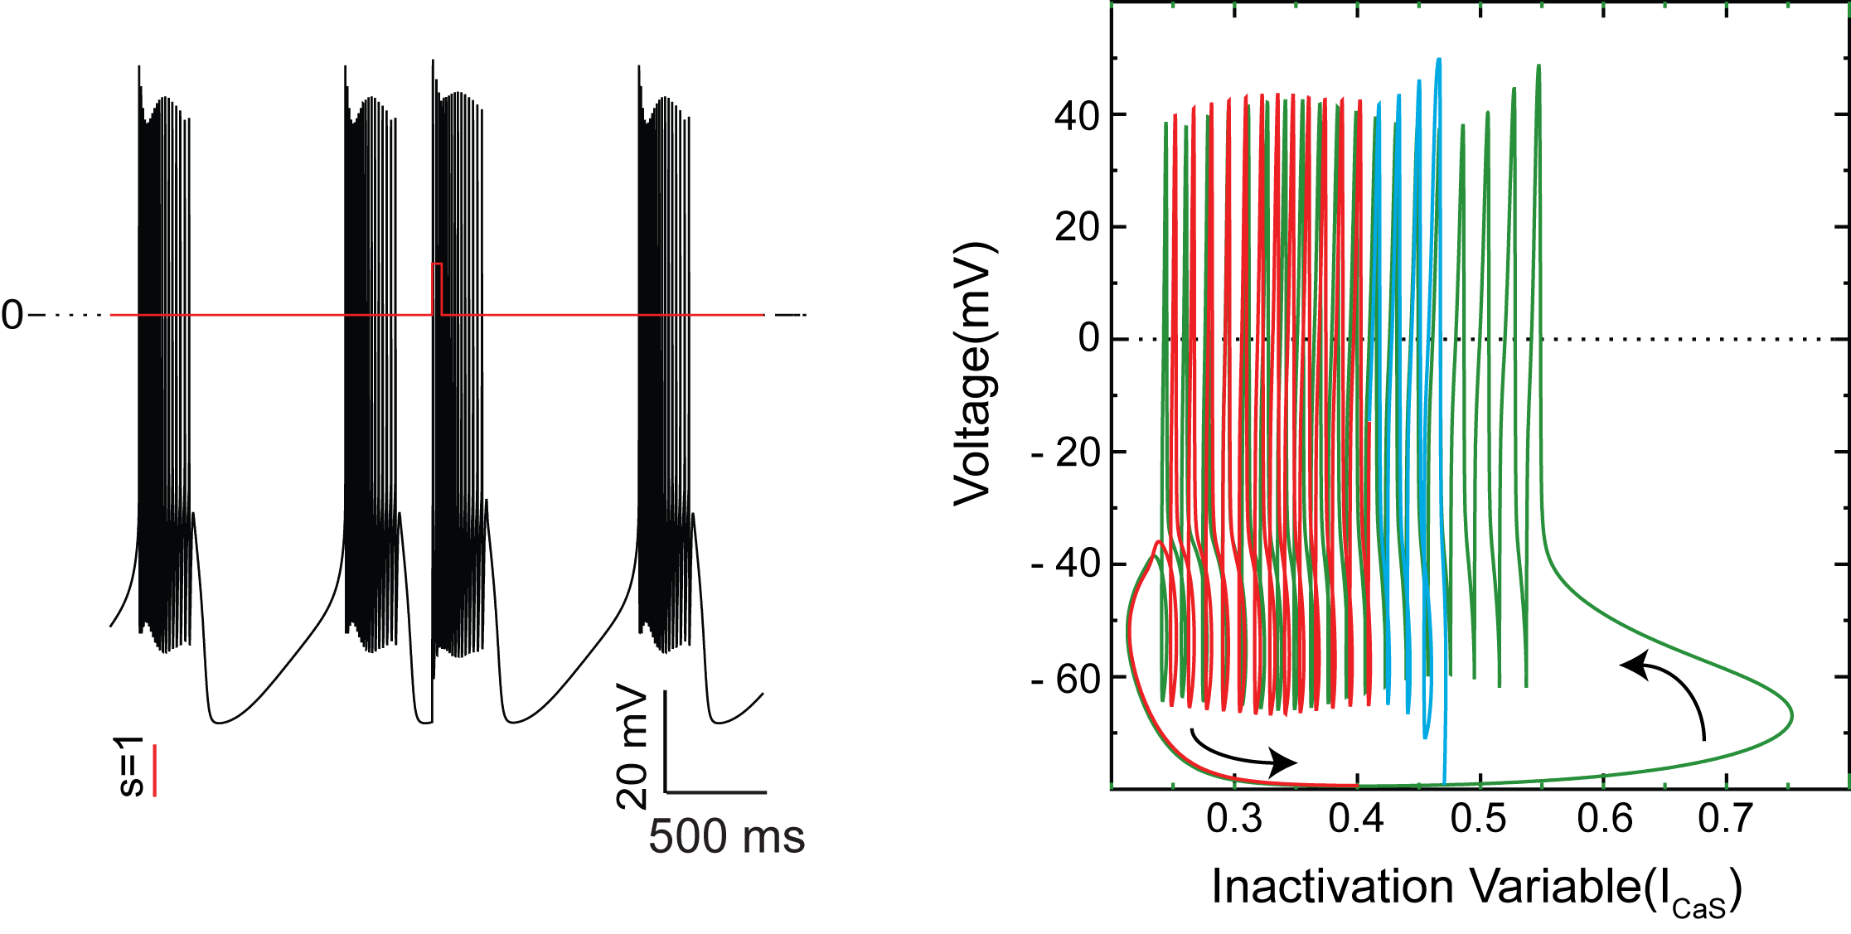
Branch Switching in Single Compartmental model
Green - Before input
Blue - During Input
Red - After Input
Notes:
The project is designed to verify one fact
Show slow dynamics for calcium
I_{Ca} active

Slide 46
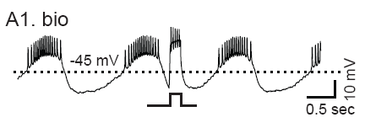
Absence of Branch Switching in biological neuron
Notes:
Two hypothesis – the channels response to voltage changes due to synaptic input might be slow or the synaptic current may not be effectively reaching the dendrites were these channels for slow oscillations are located

Slide 47
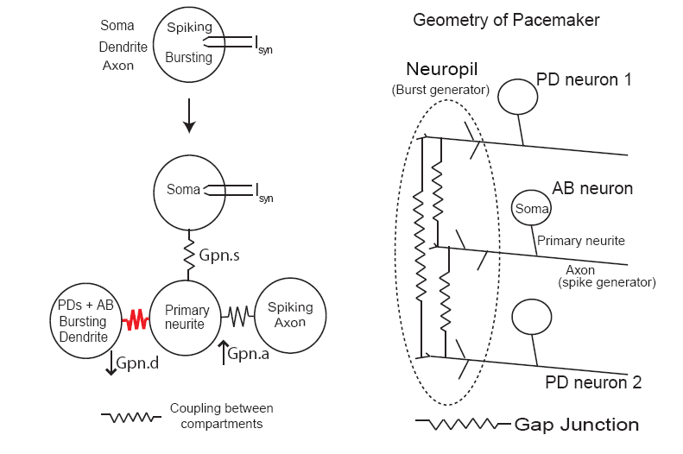
Multicompartmental Model

Slide 48
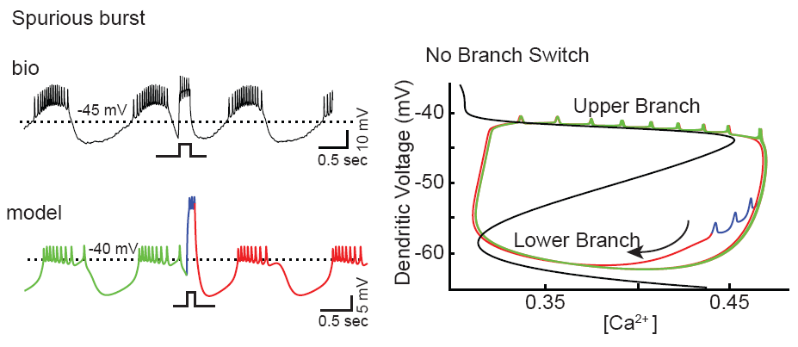
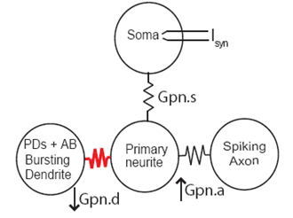
Absence of Branch Switching (Explained)
Notes:
Not quite obvious from voltage trace but much more clearer in phase plane analysis

Slide 49
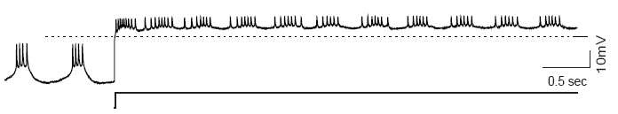
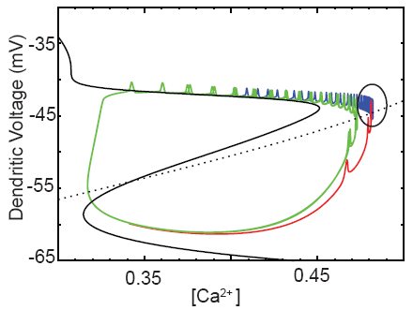
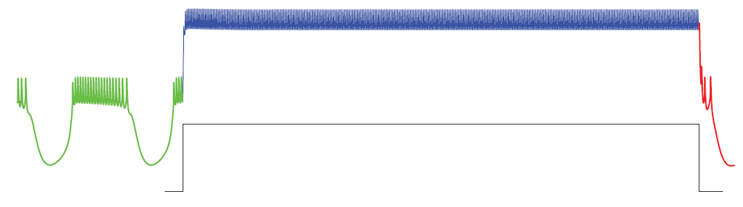
Burst is reestablished for strong continuous excitatory input in biological neuron
Biological neuron
Model neuron
Model neuron
Notes:
Biological neuron
Model neuron

Slide 50
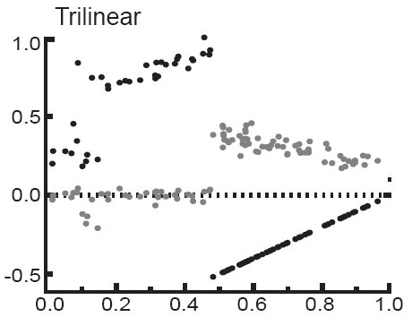
Trilinear PRC _{(Strong long inputs)}

Slide 51
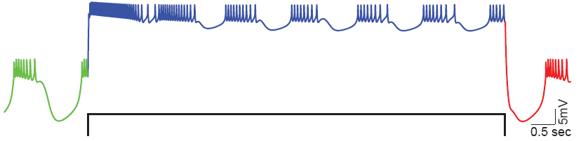
Very Slow Outward Current is sufficient for reestablishing burst in model neuron
Very Slow Outward Current should be present in primary neurite or axon for reestablishing burst
Notes:
Very Slow Outward Current should be present in primary neurite or axon
Quote – Arthur Sherman paper
Steve Prescott - paper

Slide 52
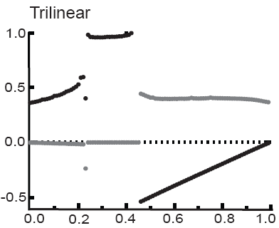
Model with Very Slow Outward Current reproduced Trilinear PRC
Notes:
To my surprise …………..
It was a bit of relief………
Unlike – this discontinuity is not artificial

Slide 53
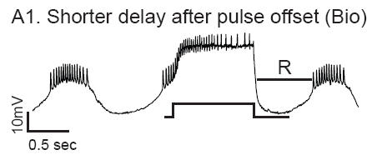
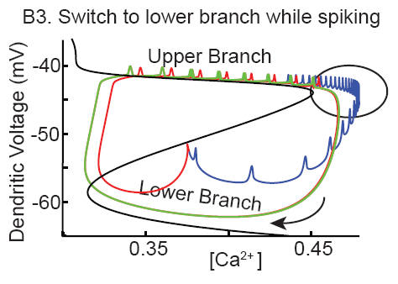




Trilinear PRC (Explained)
Activation of I_{Ks} for strong long inputs
Neuron Relaxes from compact space
Ca and I_{KCa} decreases
Input ends before crossing black curve
Neuron goes to lower branch
I_{ks} deactivates
Input ends after crossing black curve
Input goes to upper branch
I_{Ks} remains active and blocks spiking
Notes:
Activation of I_{Ks} for strong long inputs
Neuron Relaxes from compact space
Input terminates before branch switch
Neuron goes to lower branch
I_{ks} deactivates
Input terminates after branch switch
Input goes to upper branch
I_{Ks} remains active and blocks spiking

Slide 54

Model neuron captures all five PRC categories
Strong short inputs
Prominent F₂
weak intermediate inputs
Cubic PRC
Strong intermediate inputs
Bilinear PRC
Weak long inputs
U- Shaped PRC
Strong long inputs
Trilinear PRC
Notes:
Summary

Slide 55

Circuit diagram for Model

Slide 56
Summary (Aim 2)
Five shapes of PRCs were observed in biological neuron for excitatory inputs, depending on strength and duration
Our model neuron was able to reproduce all five PRC shapes and able to explain the biophysical mechanism behind all five shapes.
The phase plane analysis was more useful for understanding the phase resetting than just observation from voltage trace.
The absence of branch switching for short strong excitatory inputs is explained by the multicompartment model with spatial separation of spike and burst generation
We predict a previously unknown very slow outward current either in primary neurite or axon is sufficient to explain Trilinear PRC

Slide 57
Specific Aim 3
To predict phase locking in a network with pacemaker neuron and post inhibitory rebound (PIR) neuron reciprocally coupled through inhibitory synapse

Slide 58

Post Inhibitory Rebound (PIR) Neuron

Slide 59



fPRC construction for PIR Neuron
Morris Lecar Model
fPRC_{PIR}
Notes:
We used Morris Lecar model neuron which has both oscillatory and rebound property. A constant DC current applied to the neuron determines whether neuron exhibits pacemaker behavior or remain at steady state membrane potential at rest but has rebound property.
We give an input from oscillator neuron.
When the neuron rebounds we take a reference point. Here ‘0’ millivolt is taken as the reference point.
A next input is given at a fixed delay time after the neuron crosses the reference point
Input duration corresponds to spike duration of the oscillator neuron.
The neuron will soon be able to stabilize with a fixed response interval; what is ts and what is tr;
We repeat this for different delay times and get tr [steady] for each delay value.
If we plot tr [steady] against the corresponding delay we get fPRC
We don’t normalize the ts or tr with intrinsic period as the neuron doesn’t have any intrinsic period, so fprc is actually the ts tr plot.
In usual PRC measurement we give single input and calculate the ts and tr interval but since these neurons don’t oscillate intrinsically we cannot use the regular prc methods. And fPRC is advantage for neurons that are not intrinsically oscillator.

Slide 60



fPRC Generation for a pacemaker
fPRC_{osc}

Slide 61

Prediction of Phase locked intervals
Existence Criterion
tr_{PIR[∞]} = ts_{OSC}
tr_{OSC[∞]} = ts_{PIR}
Stability Criterion

Slide 62


Observed Mode in Network

Slide 63

Comparison between predicted and Observed Modes

Slide 64

Summary and Application (Aim 3)
fPRCs can be successfully used to predict networks with oscillatory and Post Inhibitory Rebound (PIR) neurons
fPRCs can be applied to networks in which the neurons are not oscillating intrinsically
fPRCs can also be applied in conditions where the resetting due to previous input is not complete before the next input is received (Cui et al 2009)
Notes:
fPRCs can be applied to networks in which the neurons are not oscillating intrinsically

Slide 65
Conclusions
Phase resetting methods can be applied to predict and understand the phase locking seen in neural circuits;
Notes:
In sum, in the first part of the PhD work, using model neuron, we showed our phase resetting prediction methods will work, within the limits of certain assumptions. In the second part we showed how the synaptic properties and intrinsic properties of neuron can affect the phase resetting curve. In the last section we investigated how to apply the phase resetting methods when certain assumptions in part one are violated.

Slide 66
Acknowledgement
Present and past Lab Members
Dr. Sorinel Oprisan
Will Curry
Dr. Sairam Achuthan
Shuoguo Wang
Dr. Lakshmi Chandrasekaran
Dr. Marco Huertas
Dr. Carmen C. Canavier
Dr. Astrid Prinz (Emory University).
Fred Sieling, Kavita Demla, Ryan Hooper.

Slide 67


